Slide 1
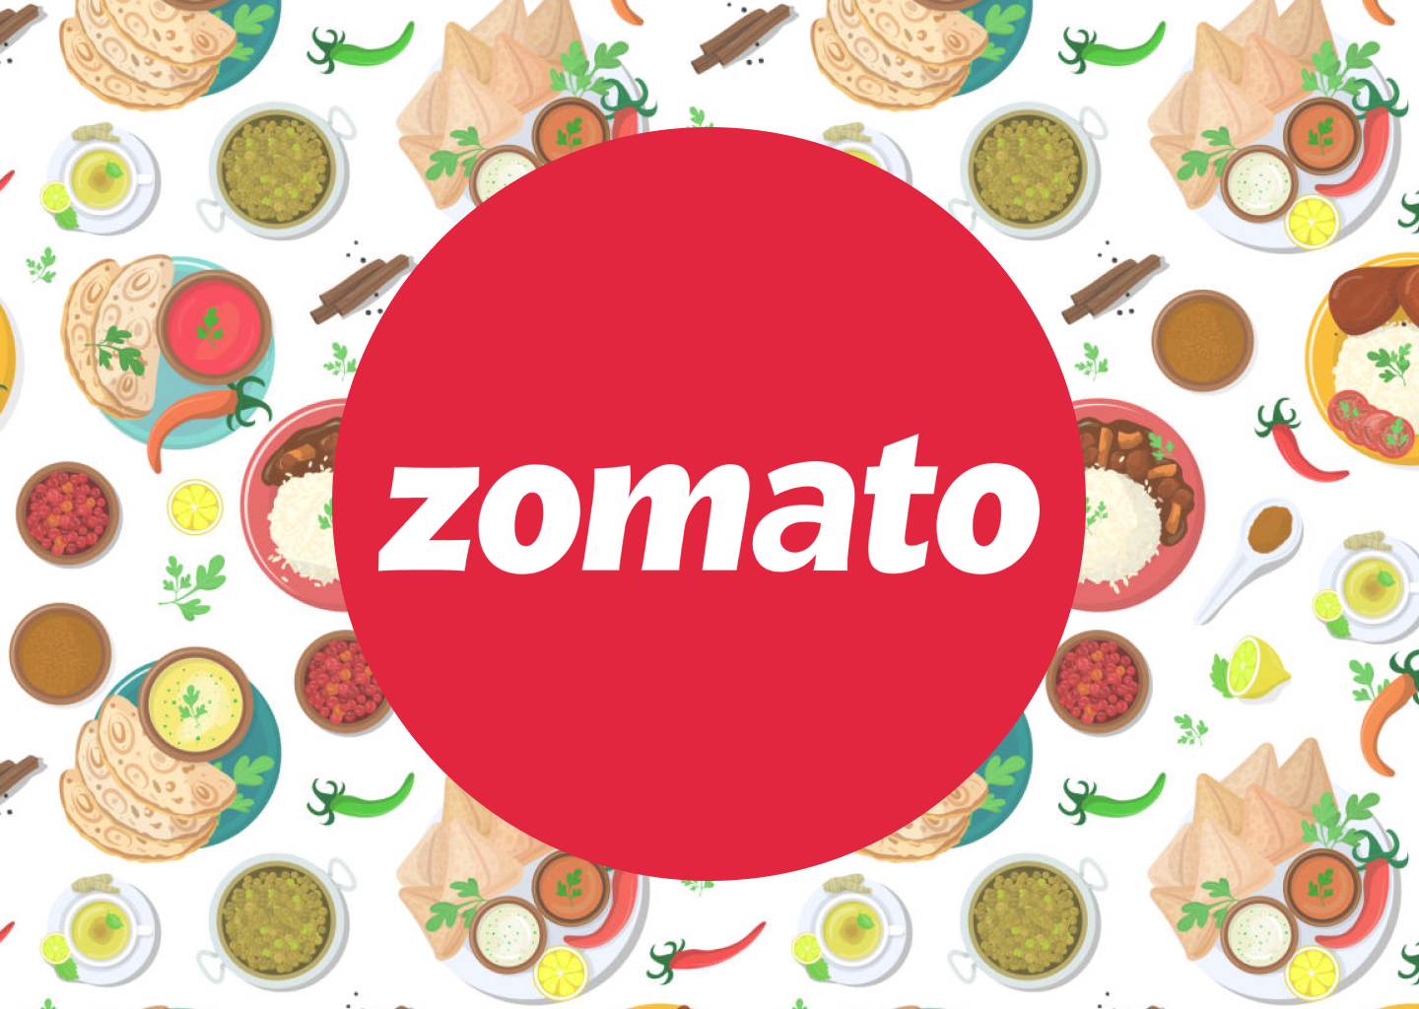
Zomato Data Analysis

Slide 2
Introduction and Objectives
Restaurant Details:
Unique IDs and names of restaurants.
Addresses and locality information.
Geographic coordinates (latitude and longitude).
Operational Features:
Availability of table booking and online delivery.
Delivery status and menu switch options.
Cuisines and Pricing:
Cuisine types served by restaurants.
Average cost for two people in local currency.
Customer Engagement:
Ratings and votes, indicating customer satisfaction.
Country-wise Distribution:
Restaurants across 15+ countries.
Country-specific details through a mapping of country codes to names.
Time-Based Insights:
Restaurant opening dates, useful for trend analysis.

Slide 3
Dataset Overview
The dataset contains two sheets:
Raw Data: Detailed information about individual restaurants.
Country Description: Maps country codes to their respective country names.
Key Attributes in the Raw Data
Restaurant Information:
Restaurant ID: Unique identifier for each restaurant.
Restaurant Name: Name of the establishment.
Address: Specific location of the restaurant.
City and Locality: Geographic placement.
Cuisine and Pricing:
Cuisines: Types of cuisines served (e.g., North Indian, Chinese).
Price Range: Levels (1 to 4) indicating the affordability.
Average Cost for Two: Specific cost details in local currency.

Slide 4
Service Features:
Has Table Booking: Indicates if table reservations are available.
Has Online Delivery: Specifies whether online delivery is offered.
Is Delivering Now: Real-time delivery status.
Engagement Metrics:
Votes: Number of votes received for customer feedback.
Ratings: Quality score given by customers.
Location Coordinates:
Latitude and Longitude: Useful for mapping restaurants.
Other Fields:
Currency: The currency in which pricing is recorded.
Datekey_Opening: Date the restaurant was added to the platform.

Slide 5
Methodology
1. Understanding the Dataset
Objective: Define the goals of the analysis, such as identifying trends in cuisines, pricing, delivery options, or regional patterns.
Data Structure: Review the dataset (both sheets) to understand available fields and their relationships.
Preparation:
Merge the Raw Data with the Country Description sheet using the Country Code column.
Identify numerical, categorical, and text-based columns.
2. Data Cleaning
Handling Missing Values:
Check for and address missing or null entries in key columns (e.g., Cuisines, Average Cost for Two, Country Code).
Replace or remove rows/columns where necessary.
Formatting:
Convert numeric columns (e.g., Average Cost for Two) to a standard format.
Parse dates (e.g., Datekey_Opening) to extract year or month if needed.
Removing Duplicates:
Check for duplicate rows based on unique identifiers like Restaurant ID.

Slide 6
3. Data Exploration
Summary Statistics:
Compute basic metrics like mean, median, and distribution for numeric columns (Average Cost for Two, Votes, etc.).
Categorical Analysis:
Count occurrences of unique values in fields like Cuisines, Country Name, and Has Online Delivery.
Geographic Analysis:
Use Latitude and Longitude for location-based insights.
4. Key Analysis
a. Country-Level Analysis:
Aggregate data by Country Name to explore:
Total number of restaurants.
Average cost for two in each country.
Proportion of restaurants offering online delivery.

Slide 7
b. Cuisine Popularity:
Analyze the Cuisines column:
Count and rank the most frequently mentioned cuisines.
Explore regional preferences by grouping cuisines by Country Name.
c. Pricing Trends:
Study the Price Range and Average Cost for Two:
Compare average pricing across countries or cities.
Analyze pricing variations for popular cuisines.
d. Customer Engagement:
Analyze Votes and Ratings to:
Identify highly rated restaurants and their features.
Check the correlation between ratings and delivery options.
e. Online Delivery Analysis:
Use the Has Online Delivery and Is Delivering Now fields:
Study how online delivery availability varies across regions.
Explore its relationship with customer ratings or restaurant pricing.

Slide 8
Analysis of Objective Questions
2 .the management wants to look at the number of restaurants opened each year
Year COUNTA of RestaurantName
2010
1080
2011
1098
2012
1022
2013
1061
2014
1051
2015
1024
2016
1027
2017
1086
2018
1102
Grand Total
9551
1.table to represent the number of restaurants opened in each country.
Countries COUNTA of fRestaurantNam
Australia
24
Brazil
60
Canada
4
India
8652
Indonesia
21
New Zealand
40
Philippines
22
Qatar
20
Singapore
20
South Africa
60
sri lankan
20
Turkey
34
United Arab Emirates
60

Slide 9
the total number of restaurants in India in the price range of 4
COUNTA of RestaurantName 388
Create a new customized price column that consists of the abbreviation/symbol of the currency along with the Average_cost_for_two value. [Use string operations to do this task]
ANSWER:-=IF(L2="Indian Rupees (Rs.)", "₹ " & S2, IF(L2="US Dollars (USD)", "$ " & S2, IF(L2="Euros (EUR)", "€ " & S2, IF(L2="Japanese Yen (JPY)", "¥ " & S2, L2& " " & S2))))
How can you create an array formula in Excel or Google Sheets to count the number of restaurants listed that do not offer online delivery, are in the lowest price range, and have an average cost for two people less than or equal to 250 Indian Rupees?
ANSWER:- =ARRAYFORMULA(SUM(('Raw Data'!N2:N9552="NO")*('Raw Data'!Q2:Q9552=1)*('Raw Data'!S2:S9552<=250)))

Slide 10
Insights from Subjective Questions
few countries where the team can open newer restaurants with lesser competition
Australia
Canada
Indonesia
Qatar
Singapore
sri lankan
the names of States and cities in the suggested countries suitable for opening restaurants.
Australia:-Armidale,Balingup.Beechworth,Dicky,Beach,EastBallina,Flaxton,Forrest,HepburnSprings,Huskisson,Inverloch,Lakes,Entrance,Lorn,Macedon,Mayfield,Middleton Beach,Montville,Palm Cove,Paynesville,Penola,Phillip Island,Tanunda,Trentham East,Victor Harbor
what is the current expenditure on food in the suggested countries, so we can keep our financial expenditure in control?
ANSWER:-=SUM(Sheet8!B8 * Sheet8!C8) =649728617

Slide 11
5. the names of restaurants from the recommended states that are our biggest competitors and also those that are rated in the lower brackets, i.e. 1-2 or 2-3.
-A: name of biggest competitors restaurants
3 Wise Monkeys
Avec Moi Restaurant and Bar
Fish Streat
Flip Burger
Lemongrass
Lucky Cat Coffee & Kitchen
MONKS
Noah's Barn Coffeenery
Satoo - Hotel Shangri-La
Skye
Sushi Masa
Talaga Sampireun
Toodz House
Union Deli
Zenbu
B:-names of restaurants those that are rated in the lower brackets, i.e. 1-2 or 2-3
Elite Indian Restaurant
Pier 70
Poets Cafe
Queen's Cafe
Star Buffet

Slide 12
6.Which cuisines should we focus on in the newer restaurants to get better feedback? Does the choice of cuisines affect the restaurant ratings?
ANSWER:-this cuisines should focus on the newer restaurants to get better
Feedback and of course the choice of cuisines affect the restaurant
Ratings
7.According to our current data, should we go for online delivery and table booking? Does that affect the customer’s ratings?
ANSWER:- The Short Answer: It Depends
While online delivery and table booking can significantly enhance a restaurant's customer experience and boost revenue, their impact on customer ratings is multifaceted and depends on various factors:
Positive Impacts:
Convenience: These services offer convenience to customers, saving them time and effort.
Accessibility: Online delivery expands your customer base, reaching those who may not be able to dine in.
Data-Driven Insights: Table booking systems can provide valuable data on customer preferences, allowing you to optimize your operations and offerings.
Potential Negative Impacts:
Food Quality and Presentation: The quality of food can deteriorate during delivery, and presentation might suffer.
Service Quality: Delivery and online booking can impact the in-restaurant dining experience if not managed well.
Customer Expectations: Customers may have higher expectations for delivery and online booking, and any shortcomings can lead to lower ratings.

Slide 13
Strategies to Mitigate Negative Impacts and Maximize Positive Ones:
Prioritize Quality and Consistency:
Food Quality: Maintain high standards, even for delivery orders.
Packaging: Use appropriate packaging to ensure food arrives in optimal condition.
Consistency: Ensure consistent quality across all service channels.
Efficient Delivery Operations:
Partner with Reliable Delivery Services: Choose reliable delivery partners to minimize delays and ensure timely delivery.
Track Orders: Implement a system to track orders and provide real-time updates to customers.
Seamless Online Booking Experience:
User-Friendly Interface: Design an intuitive and easy-to-use booking system.
Real-Time Availability: Ensure accurate and up-to-date availability information.
Flexible Booking Options: Offer flexible booking options to accommodate various customer needs.
Excellent Customer Service:
Responsive Support: Provide prompt and efficient customer support for both in-restaurant and online orders.
Personalized Service: Train staff to provide personalized service, even for delivery orders.
Effective Feedback Mechanisms: Actively seek and address customer feedback.
By carefully implementing these strategies, you can leverage the benefits of online delivery and table booking while minimizing potential negative impacts on customer ratings
To make a more informed decision, it's crucial to analyze specific data on your restaurant's performance. Consider factors like:
Current customer satisfaction ratings
The potential market for online delivery and table booking
Your restaurant's capacity to handle increased demand
The resources required to implement these services effectively
By carefully weighing these factors, you can make a strategic decision that aligns with your restaurant's goals and enhances the overall customer experience.

Slide 14
8 . Should the team keep the rate of cuisines higher? Will that affect the feedback? According to our data are the rates of cuisines and ratings, Correlated?
ANSWER:- The relationship between cuisine prices and customer ratings is complex and can vary depending on several factors, including:
1. Perceived Value:
Quality and Quantity: If customers perceive the higher price as justified by the quality and quantity of food, they are more likely to give positive ratings.
Unique Selling Proposition (USP): A unique selling point, such as a rare ingredient or special preparation technique, can justify higher prices.
2. Customer Expectations:
Brand Reputation: If your restaurant has a strong brand reputation for quality and luxury, customers may be willing to pay higher prices.
Dining Experience: The overall dining experience, including ambiance, service, and presentation, can influence how customers perceive the value of the meal.
3. Competitive Pricing:
Market Dynamics: If your competitors are charging similar prices, raising your prices might not significantly impact customer ratings.
Price Sensitivity: Consider your target market's price sensitivity. If your customers are price-conscious, raising prices could negatively impact ratings.
In conclusion, while higher prices can potentially lead to higher ratings if justified by value, it's essential to strike a balance between pricing and customer satisfaction. By carefully analyzing your data and implementing effective pricing strategies, you can optimize your revenue and maintain positive customer feedback.

Slide 15
Strategic Recommendations
Market Expansion Strategy
Strengthen Online Delivery
Focus on Popular Cuisines
Customer Engagement through Ratings and Reviews

Slide 16
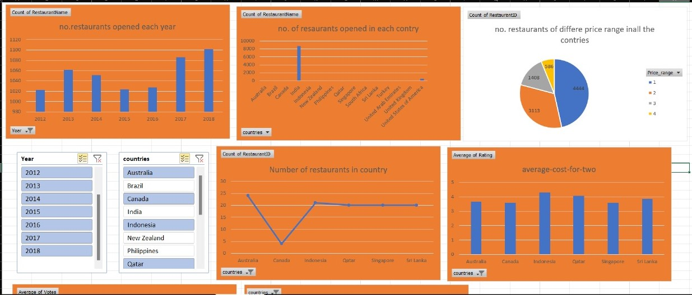

Slide 17
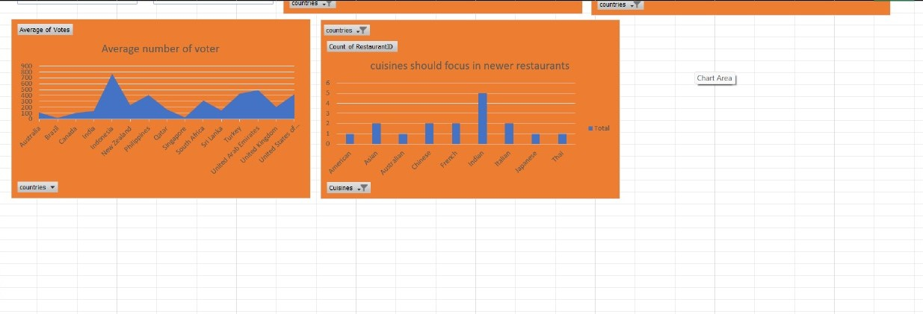

Slide 18
Conclusion
Global Presence and Market Opportunities:
India dominates the Zomato platform with the highest number of restaurants, showcasing a well-established market.
Countries like Brazil, South Africa, and Indonesia have untapped potential for growth due to lower restaurant density and increasing urbanization.
Customer Preferences:
Popular cuisines such as North Indian, Chinese, and Fast Food are consistent across regions, with local cuisines holding strong in specific markets.
There’s an opportunity to innovate by blending popular and local flavors to cater to diverse customer needs.
Pricing and Market Dynamics:
Significant variation in average dining costs reflects different market dynamics. Price-sensitive markets like India require affordable options, while premium markets like UAE allow for higher-priced offerings.
Understanding pricing trends aids in market segmentation and targeted promotions.
Digital and Delivery Trends:
Online delivery is a significant driver of customer satisfaction, with restaurants offering delivery services receiving better ratings on average.
There’s scope to enhance delivery infrastructure in underpenetrated markets to capture latent demand.
Customer Engagement:
Higher ratings and votes correlate with better restaurant performance, emphasizing the importance of customer feedback and reviews.
Encouraging user engagement through reviews can boost platform activity and credibility.

Slide 19
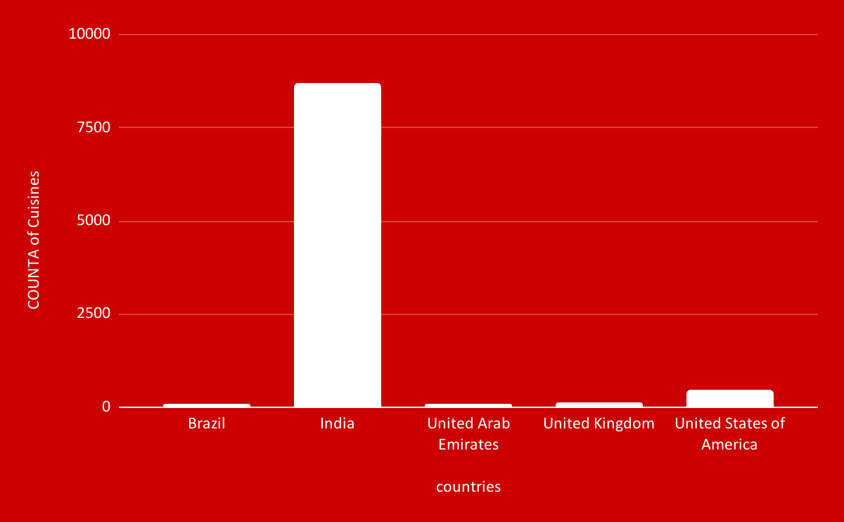
Top Countries by Number of Restaurants.

